Slide 1
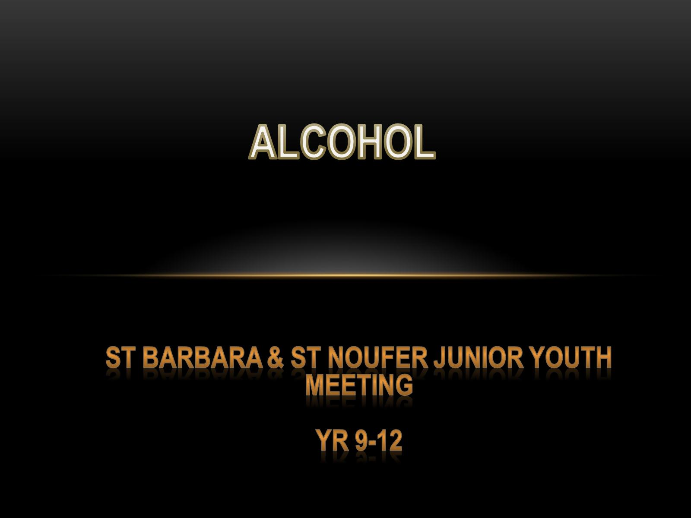
ALCOHOL

Slide 2
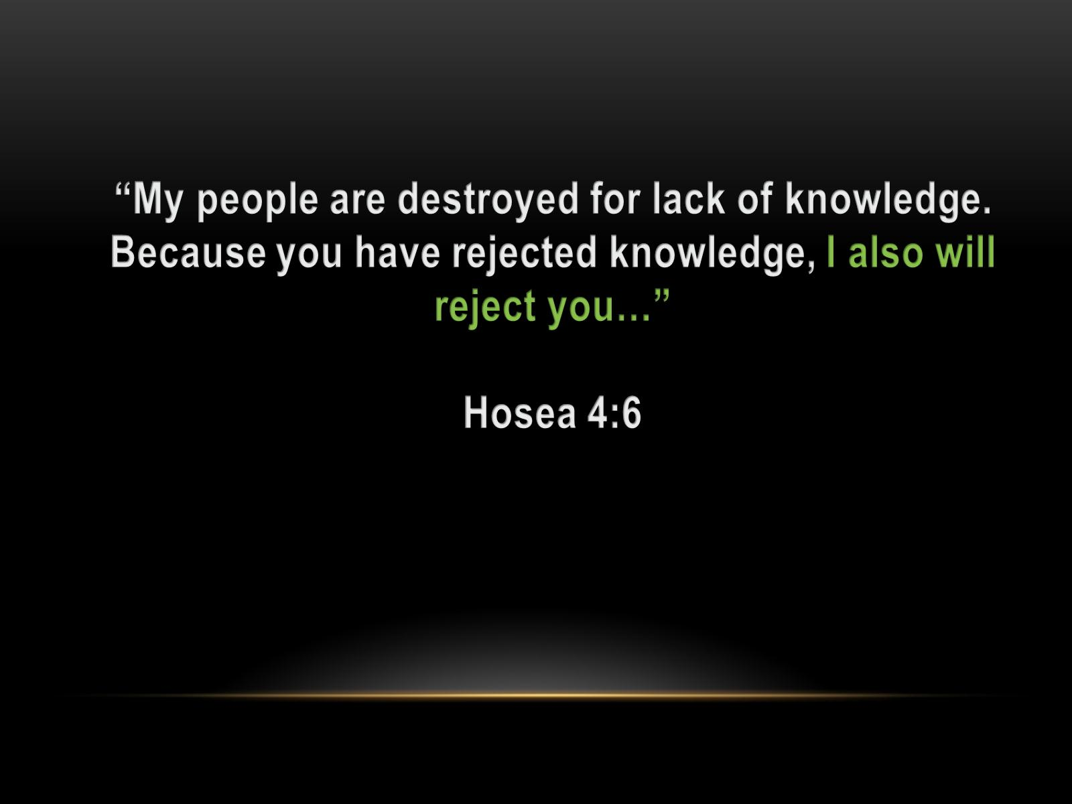
“My people are destroyed for lack of knowledge. Because you have rejected knowledge, I also will reject you…”
Hosea 4:6

Slide 3
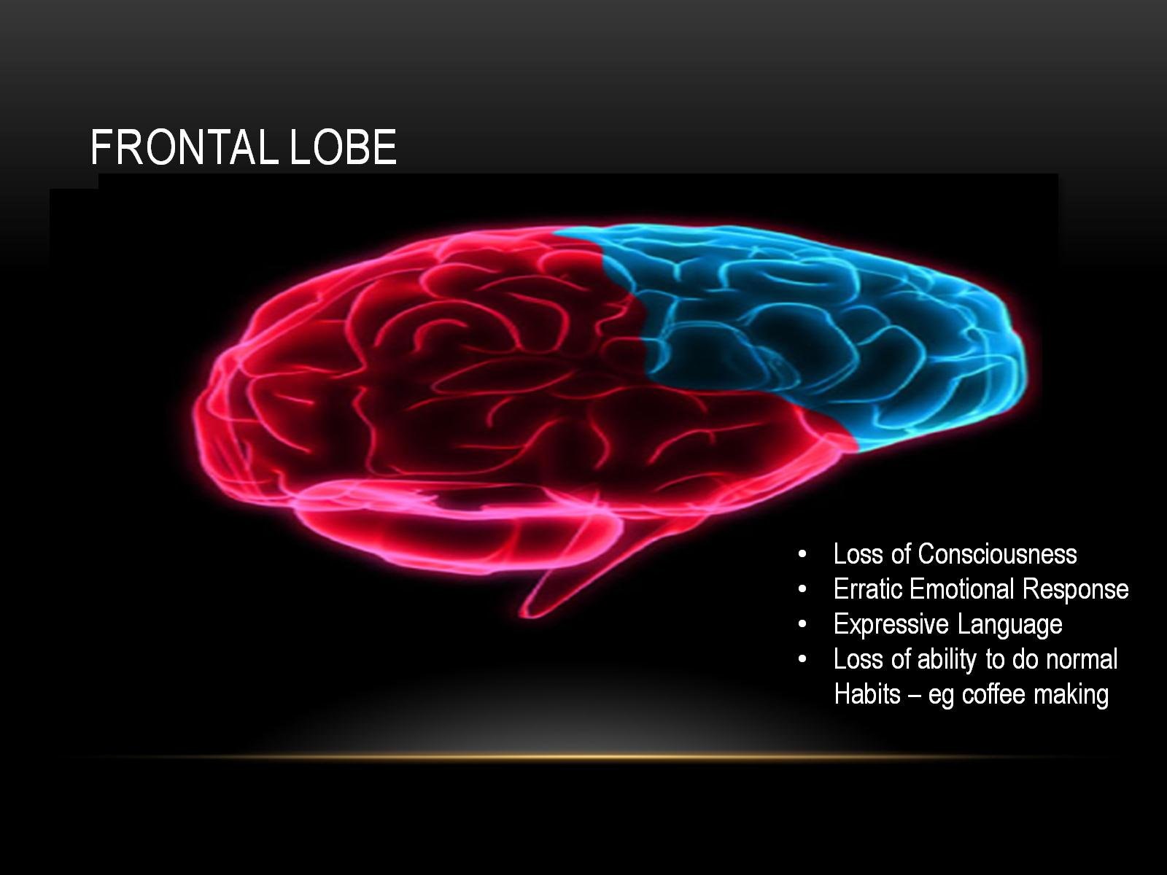
Frontal Lobe

Slide 4
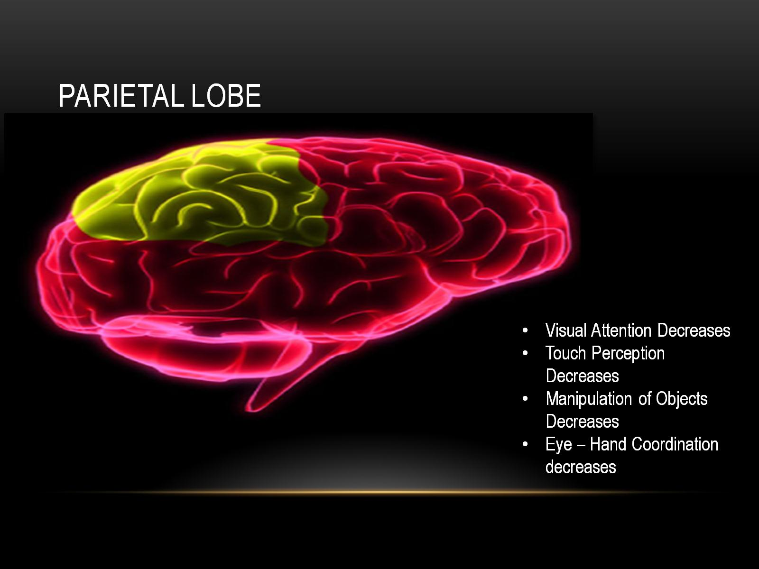
Parietal Lobe

Slide 5
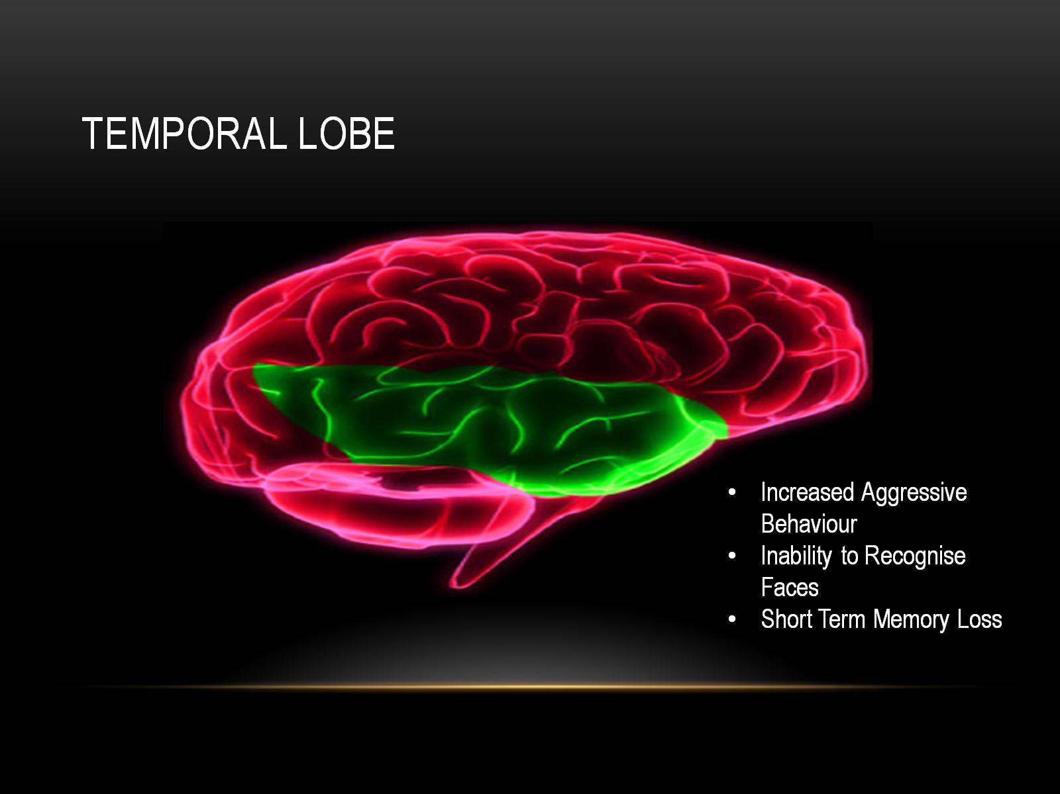
Temporal lobe

Slide 6
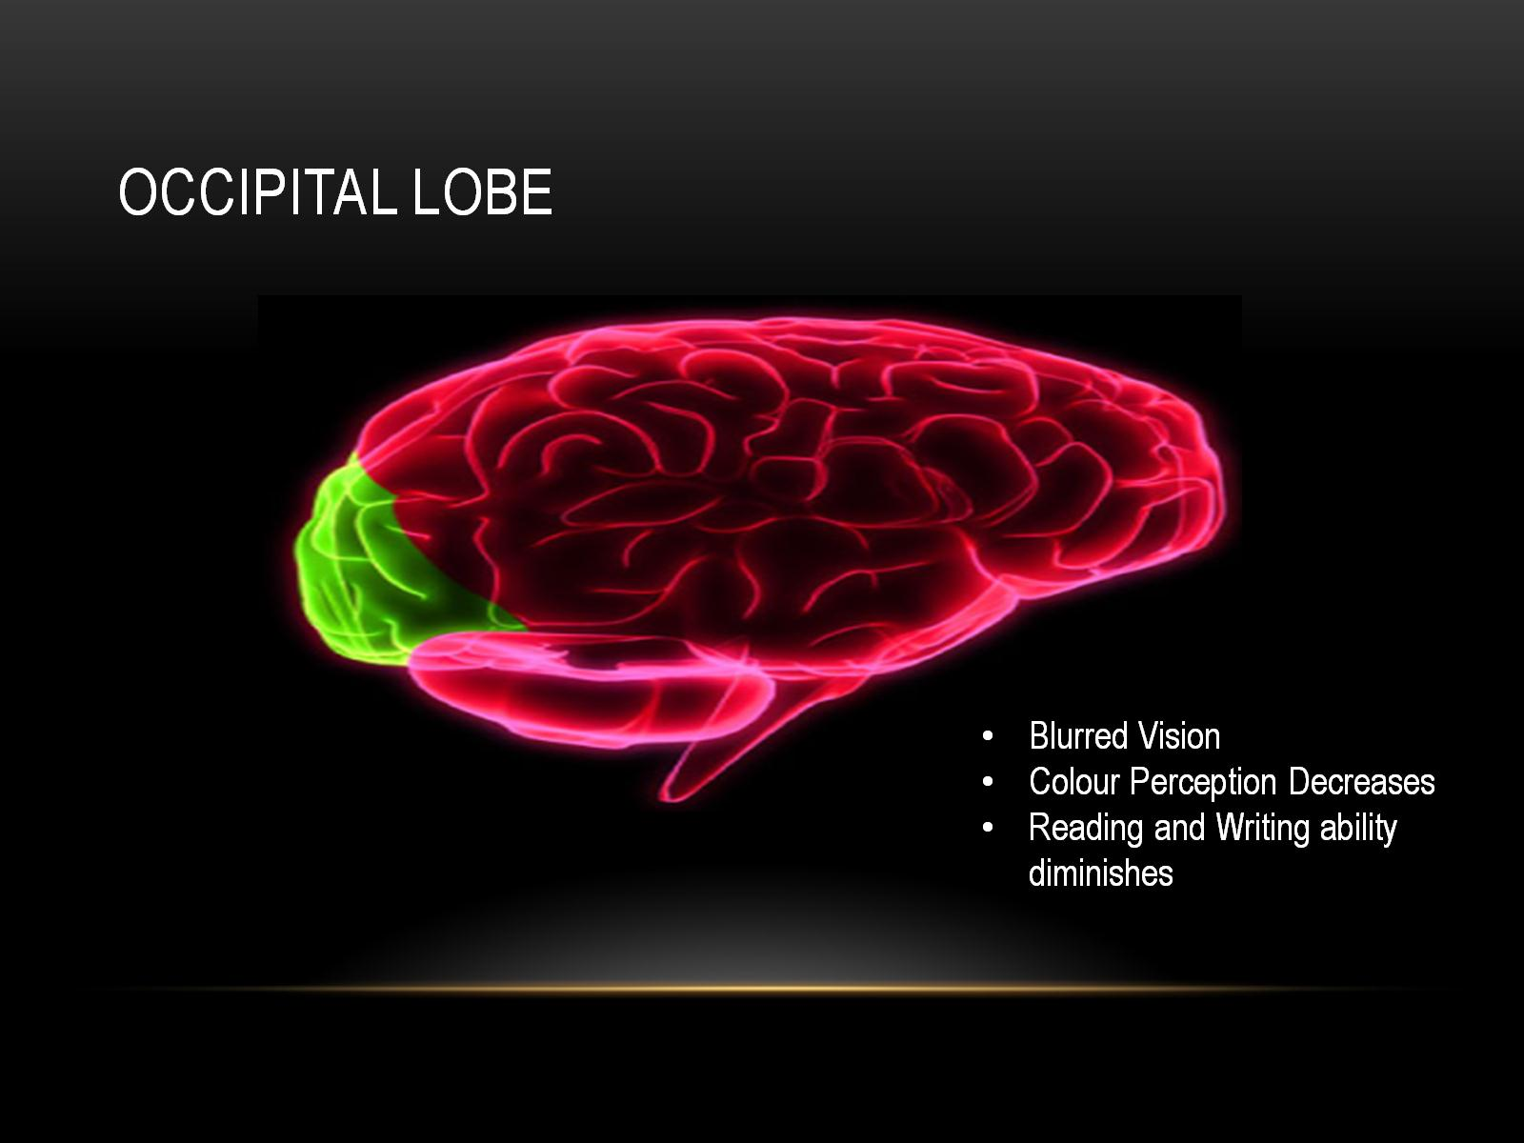
Occipital Lobe

Slide 7
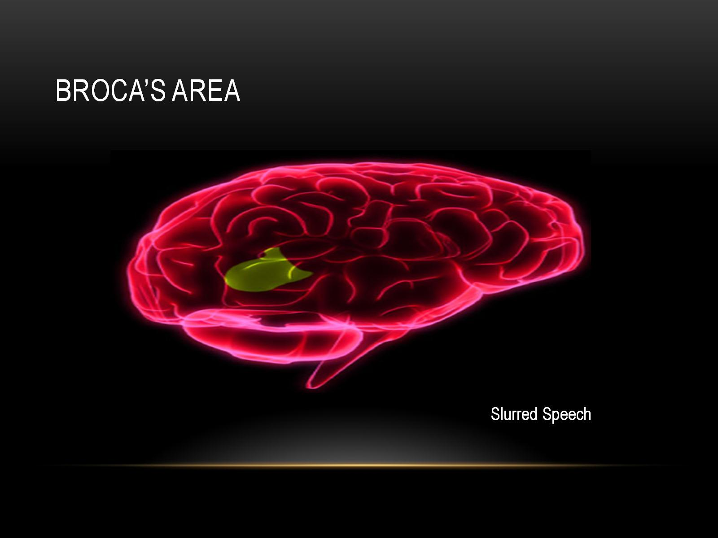
Broca’s area

Slide 8
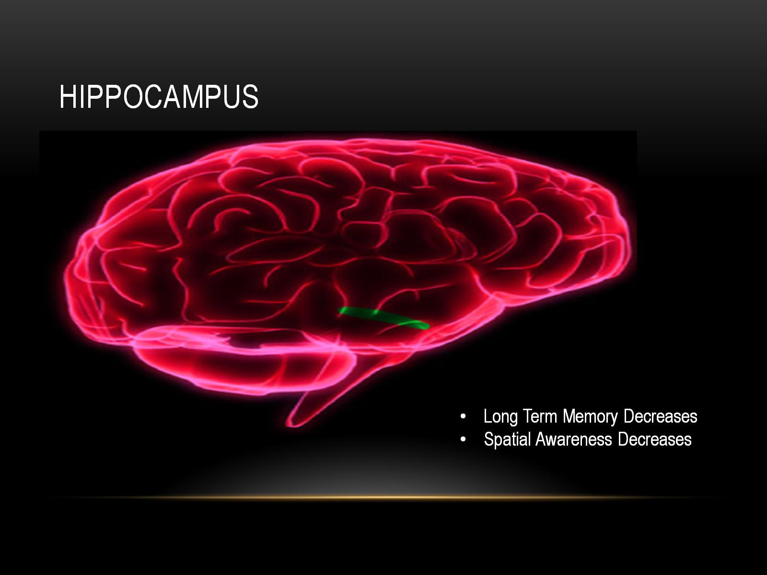
HIPPOCAMPUS

Slide 9
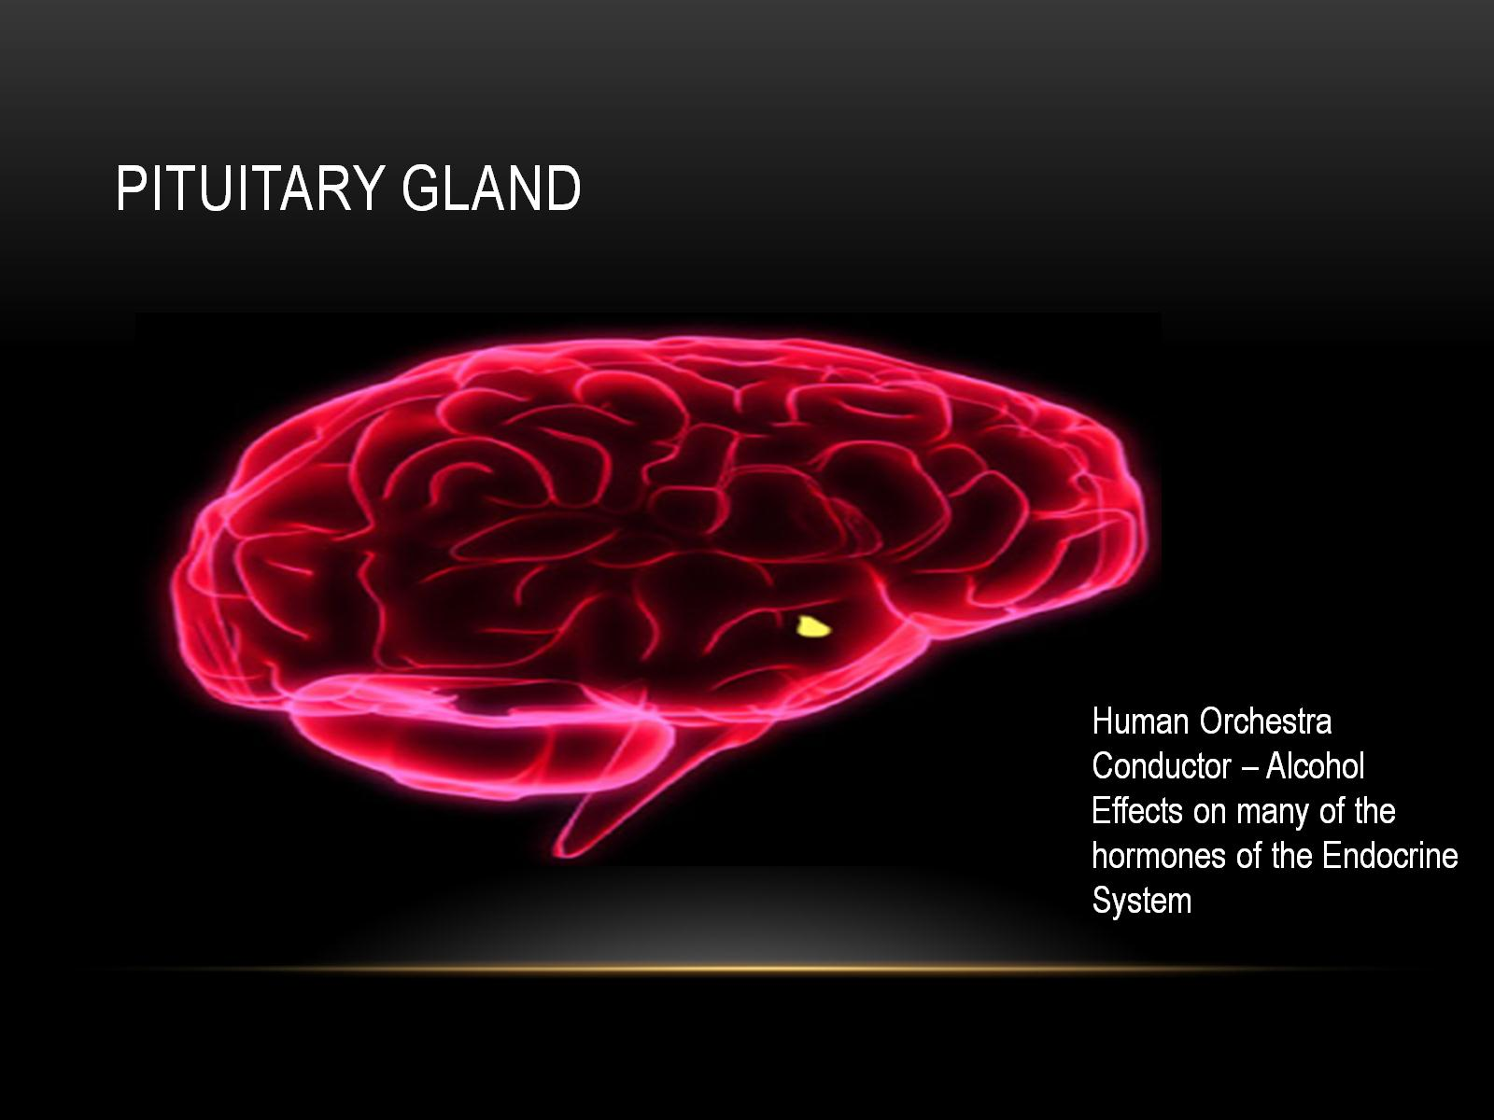
Pituitary gland

Slide 10
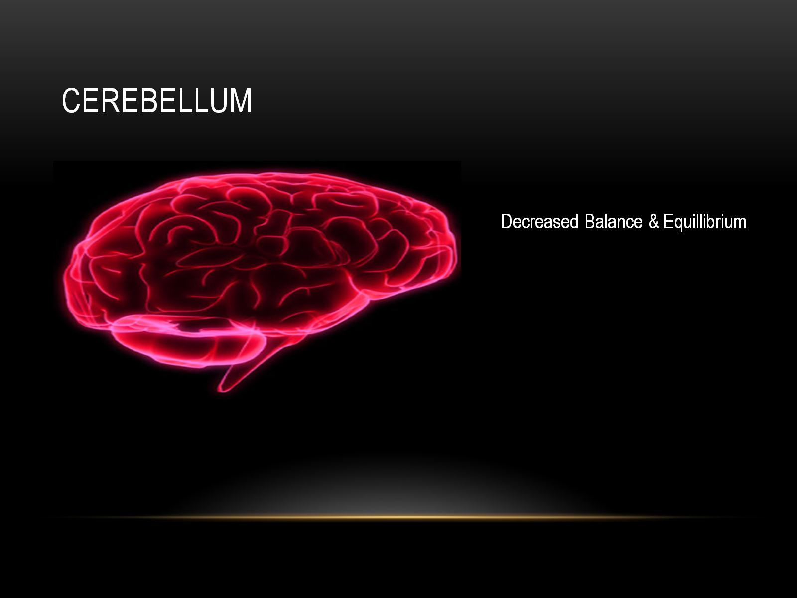
cerebellum

Slide 11
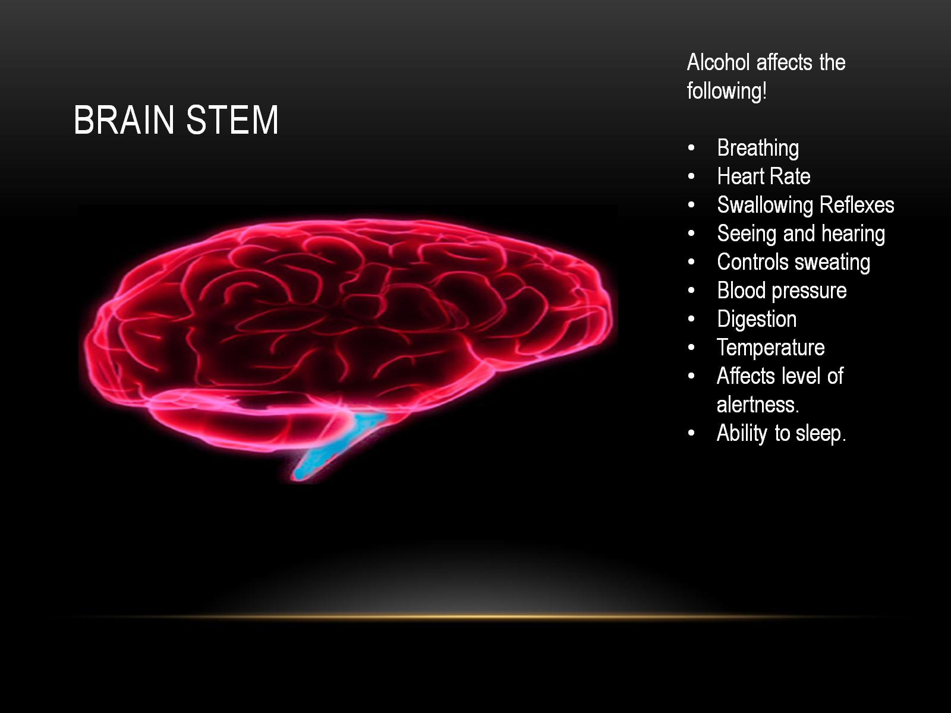
Brain stem

Slide 12
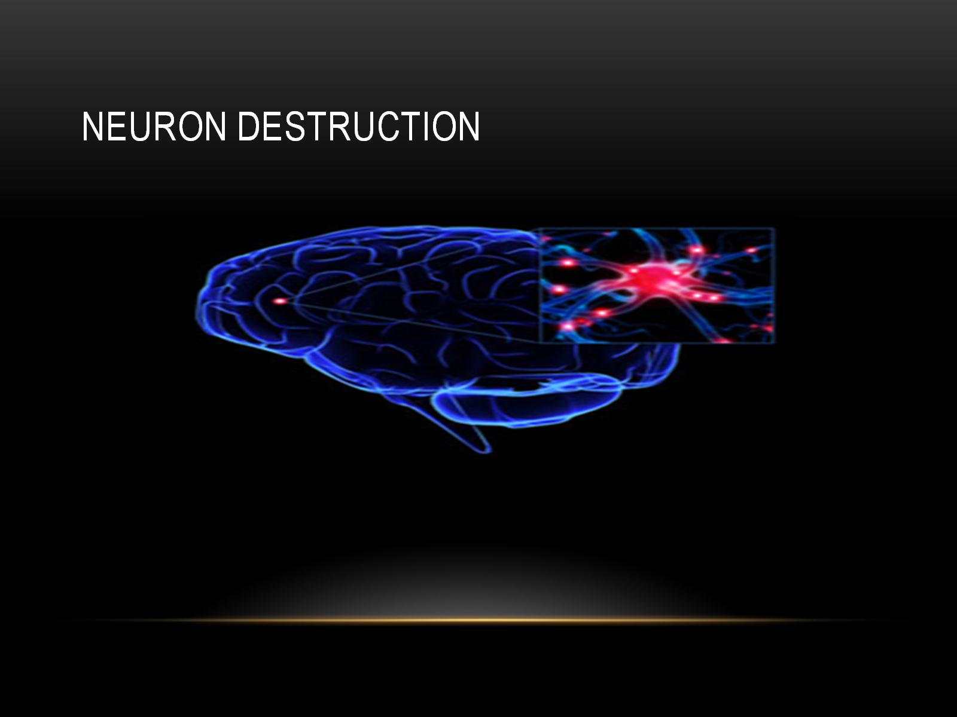
NEURON DESTRUCTION

Slide 13
